Slide 2

YPP 4th
bbv Software Services AG | Date

Slide 3




Presentation on Trello Functionalities
bbv Software Services AG | Date: 08/05/2025

Slide 4
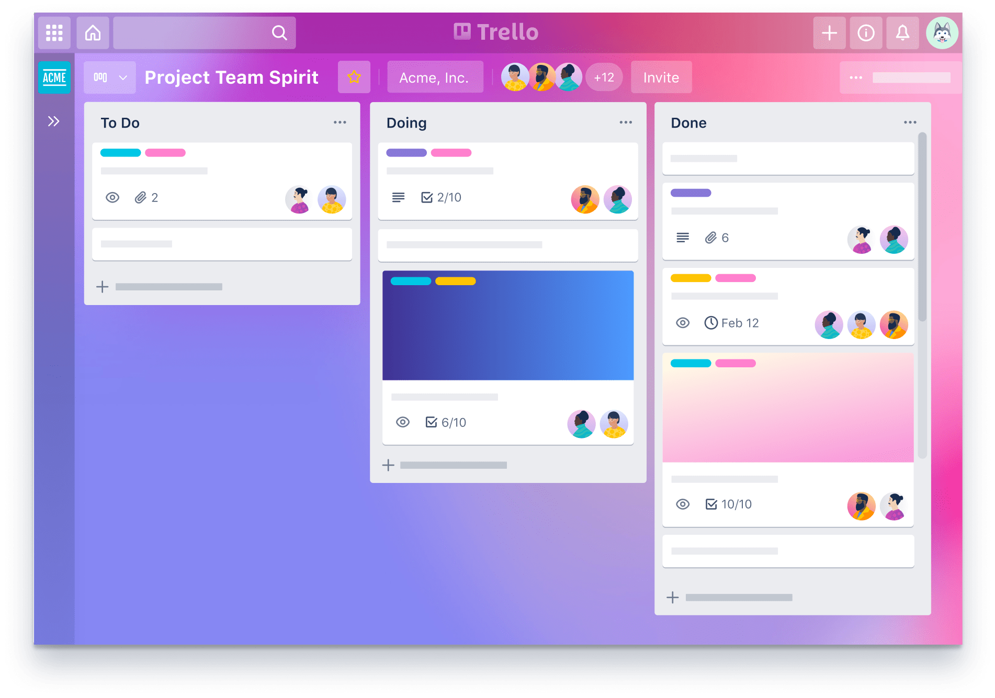
Agenda
Introduction
Functionality
UI Screens in the Trello
Entities and Relationship in Trello
Q&A

Slide 5

INTRODUCTION
What is Trello?

Slide 6
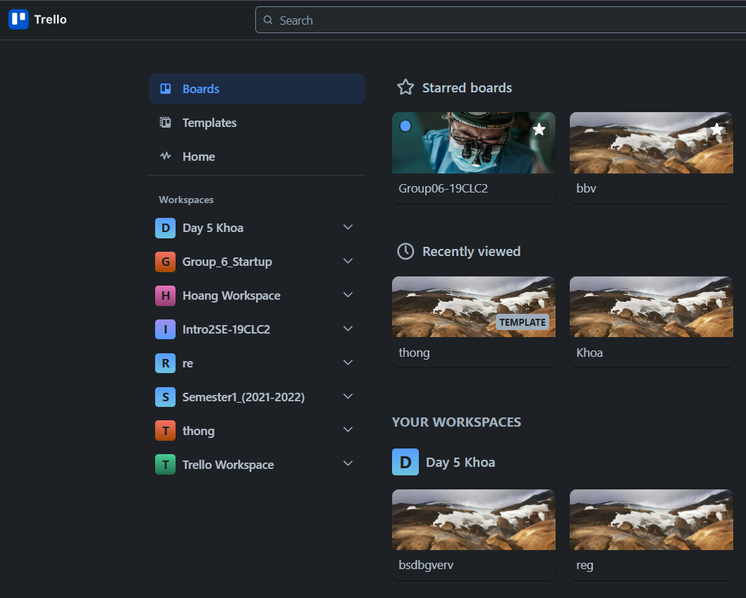
Introduction
What is Trello
Trello is a tool, organize for managing projects, tasks and track progress.
Let’s users:
Create workspace boards
Add cards to represent tasks
Add checklists to break tasks into subtasks
Set due dates to track deadlines

Slide 7

Q&A
Thank you
Intern | Vo Tran Quang Thong

Slide 9
bbv template EN
How-to guides

Slide 10
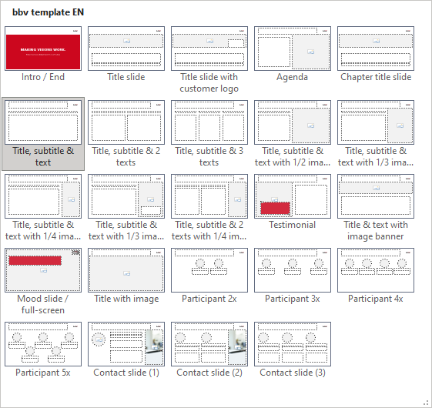
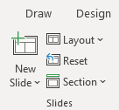
bbv Master layouts & slide library
Insert new slide
1
Click on «New Slide»
1
2
Select layout
Choose the desired layout from the pre-programmed master layouts.
2
🡪
Or select layout from slide library

Slide 11
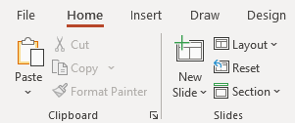
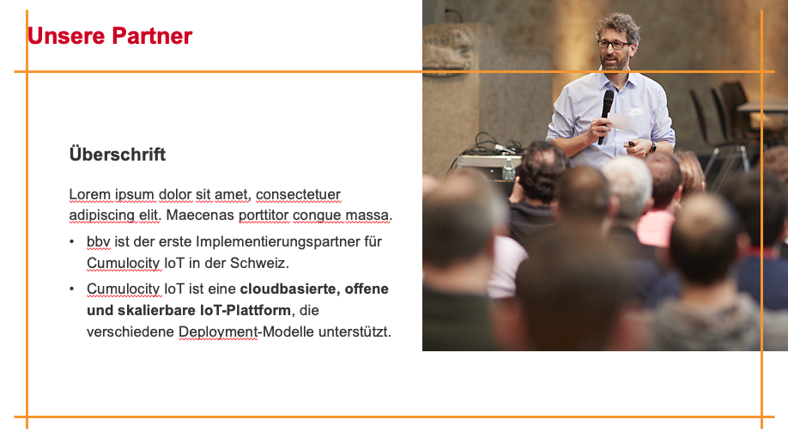
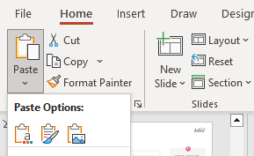
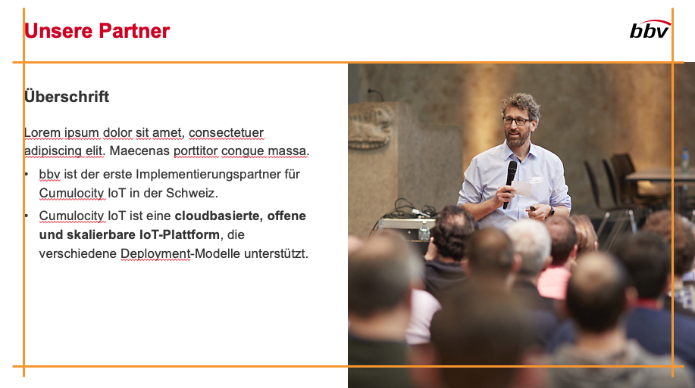
Transfer of existing slides into the new Master
1
2
3
4
Insert original slide
Copy slide in original presentation with Ctrl+C.
In the target presentation, select the slide after which the original slide is to be inserted.
Select in the tab «Home / Paste / Use Destination Theme».
Assign slide layout
Select the inserted slide
Select the desired layout in the tab «Home / Layout».
Adjust slide manually
Check all slide contents such as text blocks, images, etc. for position and size and manually adjust them to the new layout grid.
Check design
Independently check:
Font type, sizes and font colours
Colours of graphic elements
Text alignment
Coherence of the overall picture
Important:
When transferring existing slides, always carry out all four steps.

Slide 12
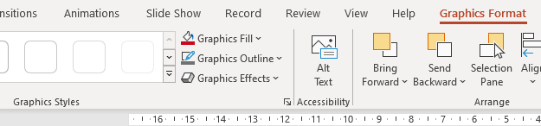

Change icon colour
Approach
Notes
Select icon
In the tab «Graphics Format» under «Graphics Styles», use «Graphics Fill» to change the colour
For some icons, the colour can be changed by using «Graphics Outline» instead of «Graphics Fill».
The colour cannot be changed if an icon is inserted as a picture. In this case, after selecting the icon, the tab «Picture Format» appears instead of «Graphics Format».
Best vector file format for icons: *.svg

Slide 13
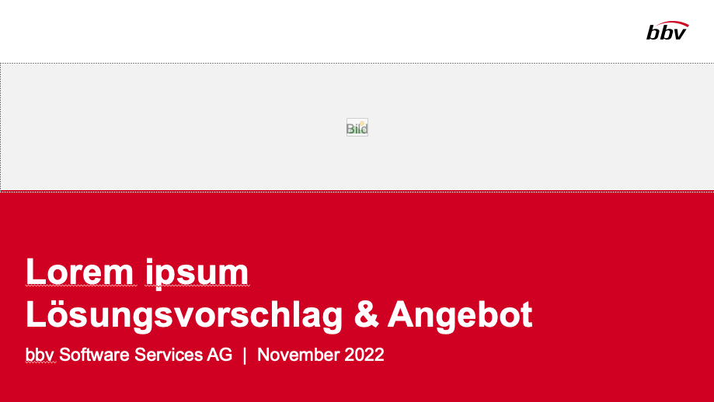


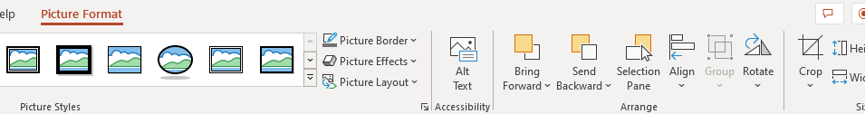


Insert image into placeholder
Insert image from external source
Click on the image icon, select image from Sharepoint or other source
The bbv image library is here locally located: C:\Users\Public\bbv_templates\Marketing\PPT-Bibliotheken\Bilder-Bibliothek
Or: copy image from external source with Ctrl+C, select the placeholder, then paste with Ctrl+V
Adjust
Select the image
Click in the tab «Picture Format» on «Crop»
Adjust the image composition by moving the image
Resize the image by clicking and dragging the outer circles.
Click again on «Crop» to finish the adjustments

Slide 14


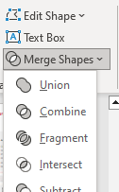

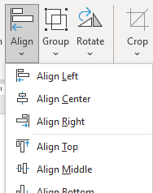

Insert image into mock-up screen (mobile/laptop)
Mock-up
Paste image
Copy image from external source with Ctrl+C and paste with Ctrl+V
Image mask
Adjust size & determine image area:
Place image behind image mask
Adjust image size and determine image area
Image mask
Crop image to image mask
Select image
Select image mask
Click in the tab «Shape Format / Merge Shapes» on «Intersect»
Combine image with mock-up
Place image behind mock-up
Activate image and mock-up and align both horizontally (Align Center) and vertically (Align Middle)
Group image and mock-up with Ctrl+G

Slide 15
bbv template EN
Style guide

Slide 16
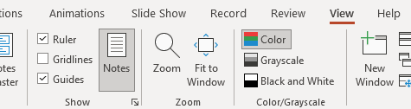

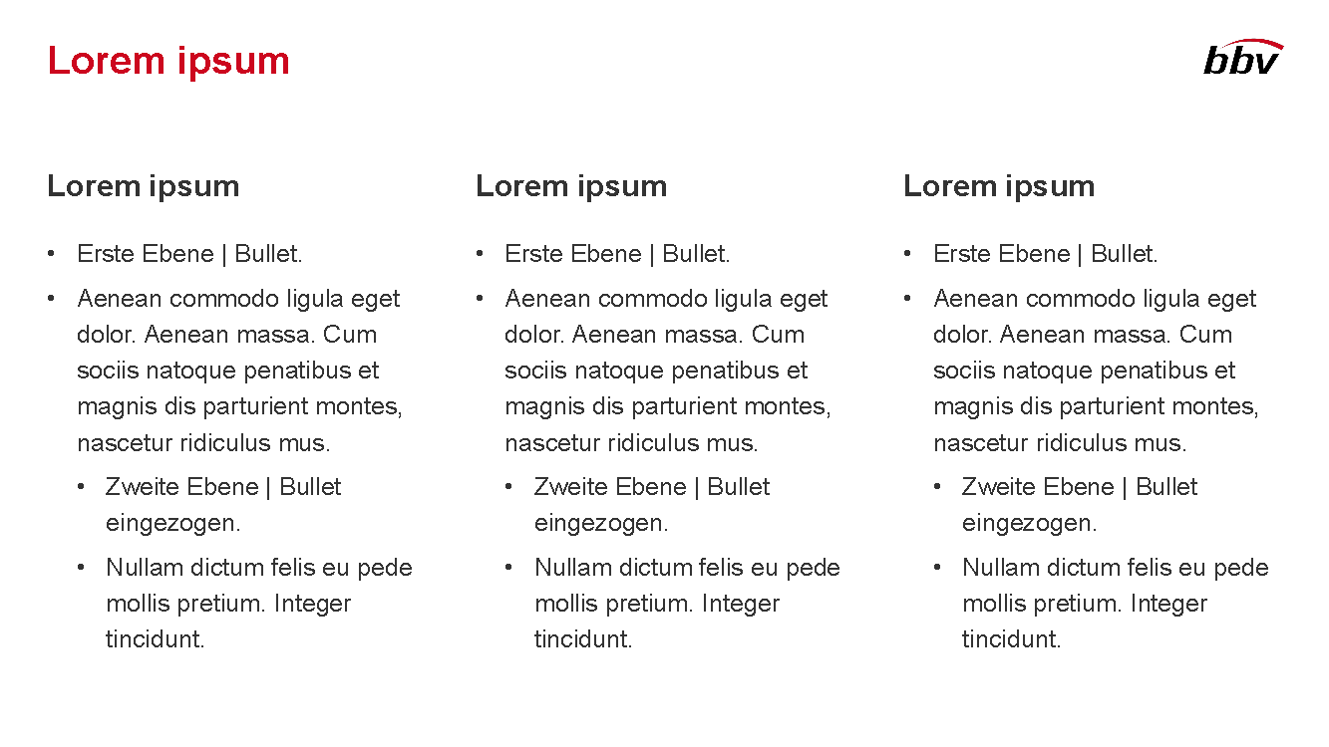
Working area, guides & ruler
Working area
Depending on the slide, a single-column layout, a 2-column or 3-column layout is used.
Display the ruler and guides in the «View» tab.

Slide 17
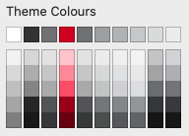
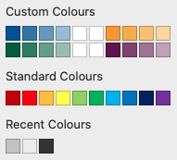
bbv colour theme
Always OK!
Never, please!
Default text colours
Main accent
Colours for diagrams, charts, graphs etc.
Use selectively and sparingly
Never, please!
Colours for diagrams, charts, graphs etc.
Colours for diagrams, charts, graphs etc.

